Slide 1

Customer Segmentation Analysis
Understanding the need to categorize customers for better marketing strategies.

Slide 2

01
Business Overview

Slide 3
Definition and Importance of customer segmentation
Customer segmentation is the practice of dividing a company's customers into groups based on shared characteristics such as demographics, purchasing behavior, or preferences. This enables businesses to understand their customers better, create targeted marketing strategies, and improve customer service.
Customer segmentation is critical for businesses as it allows for personalized marketing approaches, maximizes sales by targeting specific groups, enhances customer retention by addressing individual needs, and improves resource allocation by focusing efforts on the most profitable segments.

Slide 4

Data Source
With growing demands and cut-throat competitions in the market, a Superstore Giant is seeking your knowledge in understanding what works best for them. They would like to understand which products, regions, categories and customer segments they should target or avoid.
Dataset containing Information related to Sales, Profits and other interesting facts of a Superstore giant.
Kaggle: Superstore dataset

Slide 5
Metadata
Row ID ➔ Unique ID for each row.
Order ID ➔ Unique Order ID for each Customer.
Order Date ➔ Order Date of the product.
Ship Date ➔ Shipping Date of the Product.
Ship Mode ➔ Shipping Mode specified by the Customer.
Customer ID ➔ Unique ID to identify each Customer.
Customer Name ➔ Name of the Customer.
Segment ➔ The segment where the Customer belongs.
Country ➔ Country of residence of the Customer.
City ➔ City of residence of of the Customer.
State ➔ State of residence of the Customer.
Postal Code ➔ Postal Code of every Customer.
Region ➔ Region where the Customer belong.
Product ID ➔ Unique ID of the Product.
Category ➔ Category of the product ordered.
Sub-Category ➔ Sub-Category of the product ordered.
Product Name ➔ Name of the Product
Sales ➔ Sales of the Product.
Quantity ➔ Quantity of the Product.
Discount ➔ Discount provided.
Profit ➔ Profit/Loss incurred.

Slide 6
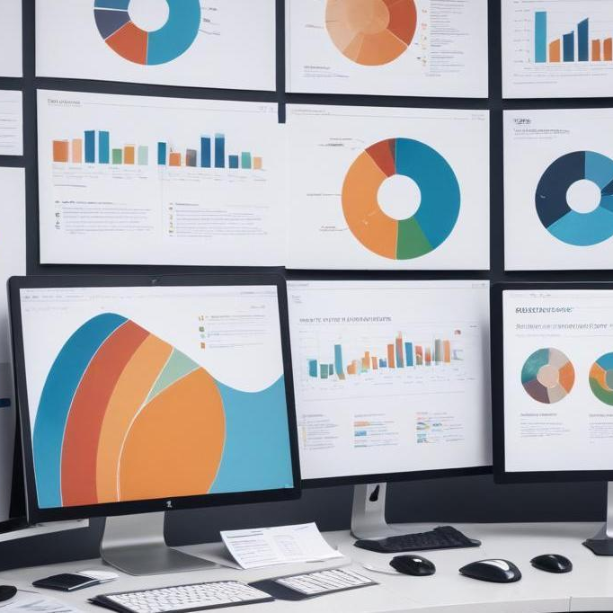
02
Methods and Tools

Slide 7
RFM Analysis
Recency, Frequency, and Monetary (RFM) analysis is a powerful marketing technique used to segment customers based on their purchasing behavior.
Component | Meaning | Example
Recency | How recently a customer made a purchase. Customers who purchased more recently are more likely to respond to promotions or re-engage. | Customer A last purchased 5 days ago → high Recency score Customer B last purchased 300 days ago → low Recency score
Frequency | How often a customer makes a purchase in a given period. Frequent customers are often loyal and more engaged with the brand. | Customer A made 12 purchases → high Frequency Customer B made 2 purchases → low Frequency
Monetary | How much money the customer has spent in total. Customers who spend more are usually more valuable. | Customer A spent $1,500 → high Monetary Customer B spent $50 → low Monetary

Slide 8
Power BI
RFM (Recency, Frequency, Monetary) Analysis in Power BI is a powerful customer segmentation technique used to evaluate and group customers based on their purchasing behavior. By importing transactional data into Power BI, analysts can calculate the recency, frequency, and monetary value for each customer. These RFM metrics are then scored and used to segment customers into meaningful groups such as "Best Customers," "Loyal Customers," or "At-Risk Customers." With Power BI's interactive visuals and DAX formulas, businesses can build dynamic dashboards to monitor customer segments, identify trends, and develop targeted marketing strategies that drive customer retention and sales growth.

Slide 9

03
RFM Analysis

Slide 10
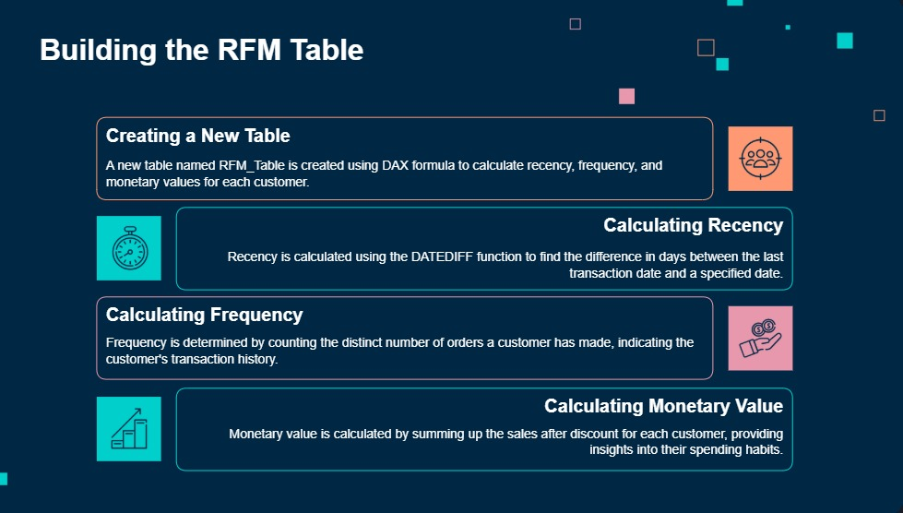
Building the RFM Table
Creating a New Table
A new table named RFM_Table is created using DAX formula to calculate recency, frequency, and monetary values for each customer
Calculating Recency
Find the last transaction date using the MAX() formula against the 'order date' column. Then Recency is calculated using the DATEIFF function to find the difference in days between the last transaction date and specified date (timestamp of data extraction)
Calculating Frequency
Frequency is determined by counting the distinct number (DISTINCTCOUNT function) of orders a customer has made, indicating the customer's transaction history
Calculating Monetary
Monetary value is calculated by summing up the sales after discount for each customer, providing insights into their spending habits

Slide 11
Building the RFM Table
Determining Recency Score
Measures how recently the customer made their last purchase. The value is then ranked (usually on a scale of 1 to 5) using PERCENTILE.INC() and SWITCH() to determine their relative their recently last purchase. A higher score indicates more recent activity from the customer, which is better
Determining Frequency Score
Measures how often a customer shops. The value is then ranked (usually on a scale of 1 to 5) using PERCENTILE.INC() and SWITCH() to determine their relative frequency. A higher score indicates more frequent purchases from the customers, which is better
Determining Monetary Score
Measures how much money the customer has spent in total. The value is then ranked (usually on a scale of 1 to 5) using PERCENTILE.INC() and SWITCH() to determine their relative spending. A higher score indicates more spending money from the customers, which is better

Slide 12
Building the RFM Table
R, F, and M scores are combined into a 3-digit code, for example:
555 = highest in all categories
132 = recency 1, frequency 3, monetary 2
Based on the rfm_score, customers are grouped into segments, using the SWITCH() logic in DAX.
RFM Score | Segment | Description
111 - 155 | Need Attention | Customers in this segment have not made purchases for a long time (low recency) and may stop being customers. There are two possible behaviors: (1) Customers who previously had medium to high purchase frequency and spending (monetary). They might have bought products with long-term usage or made bulk purchases. (2) Customers with historically low purchase frequency and spending, who may only be interested in specific products and have no intention of making frequent repeat purchases.
211 - 345 | At Risk | Customers in this segment are considered at risk, meaning they are at risk of not making purchases for a long time. Their transaction frequency has started to decline.
351 - 445 | Potential | Customers who continue to make purchases relatively frequently, although their frequency and spending are low to medium.
451 - 455 | Loyal | Customers who still make transactions (but not as frequently as Champions) with medium to high purchase frequency and spending.
511 - 555 | Champions | There are two possible types of customers in this segment: (1) New customers who appear to have started shopping recently but have relatively low frequency and spending. (2) Long-time customers who continue to make purchases with very high frequency and spending.

Slide 13
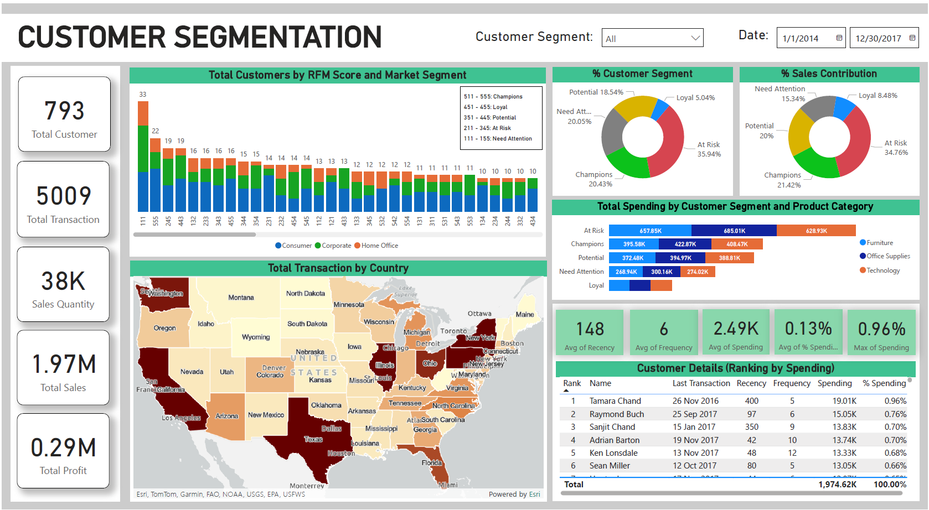
Building Dashboard

Slide 14
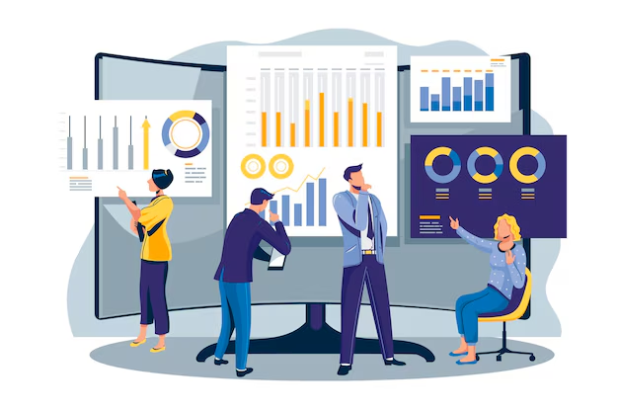
04
Business Insight and Recommendation

Slide 15
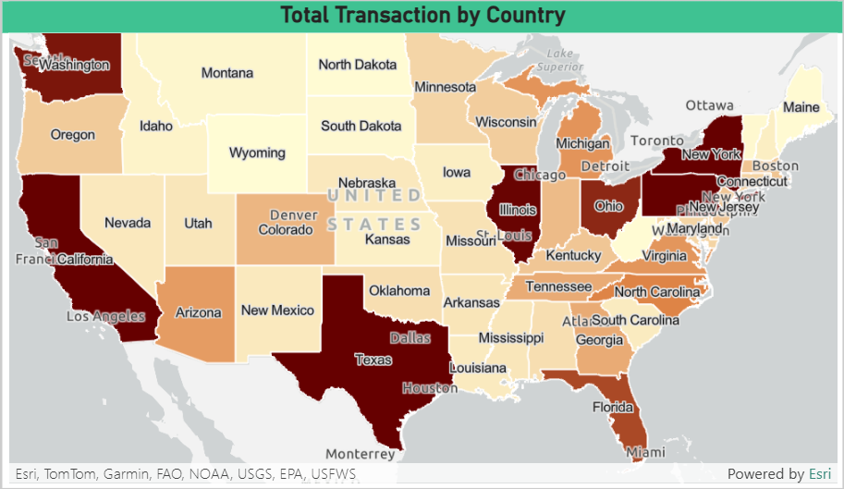
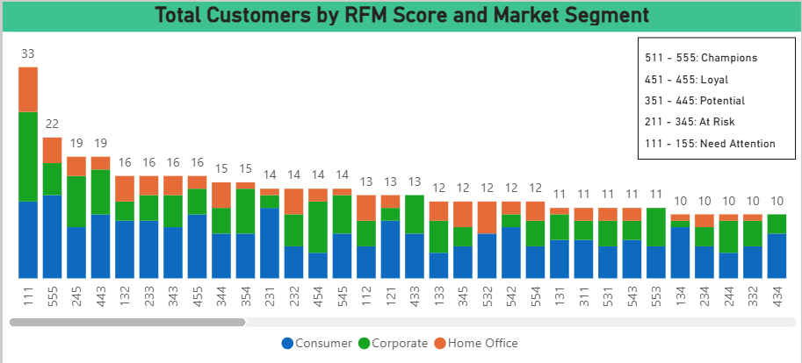
Business Insight
Insight
The adjacent image illustrates the distribution of total transactions across different states from 2014 to 2017. The darker the color, the higher the number of transactions. Some of the states identified as top transaction hubs include Washington, California, Texas, Illinois, New York, Pennsylvania, and Ohio. This information serves as a valuable reference for developing targeted marketing strategies—for instance, optimizing product offerings and special discounts in regions with increasing transaction volumes or rewarding customers with the highest purchases in states with the highest transaction levels.
Insight
The customer distribution graph based on RFM scores from 2014 to 2017 reveals that customers with an RFM score of 111 have the highest count. This indicates a significant number of customers who rarely make transactions and whose frequency and spending are very low—potentially signaling a lack of interest in the available products. In second place are customers with an RFM score of 555, which is an excellent sign as it demonstrates high loyalty and strong attachment to the company.

Slide 16
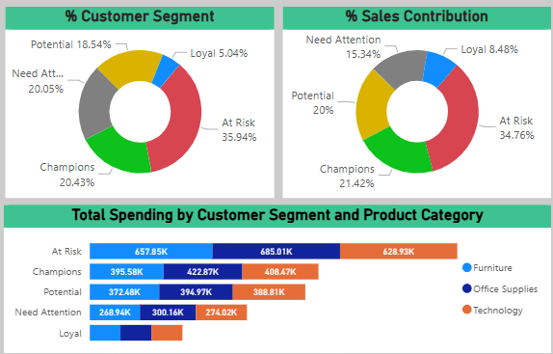
Business Insight
Insight (Based on Sales Data 2014 - 2017)
📌 At Risk Segment: This segment dominates with a percentage reaching 35.94%, contributing the highest to total sales at 34.76%. This should be a focus for the company, as it may impact sales and profitability. Customers in this segment have begun to make purchases less frequently, indicating a potential risk of disengagement.
📌 Champions & Loyal Segments: The percentage of customers in the Champions and Loyal categories is relatively high (the second-largest, exceeding 25%). Their contribution to total sales is also significant, and maintaining their engagement is crucial for long-term success.
📌 Potential Segment Increasing customer interest in this segment could be beneficial, as they currently contribute around 20% to total sales. Strengthening this group's purchasing behavior could further improve overall company performance.
📌 Need Attention Segment This segment accounts for approximately 20% of customers, with a 15.34% contribution to sales over the past few years. Strategic efforts to re-engage these customers may help boost future revenue.
📌 Product Preferences Across Segments: The types of products favored and frequently purchased by customers in each segment are largely uniform. Customers across all categories spend the most on office supplies, indicating that these products are the most sought-after and needed.

Slide 17
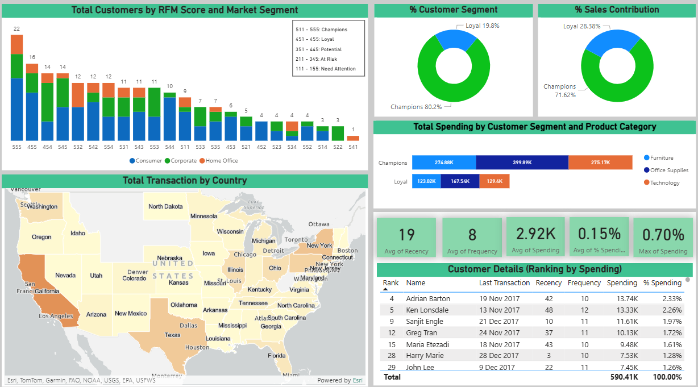
Action Needed
Action #1: Rewarding Top Customers
Provide special rewards for customers with the highest purchases. For example, Adrian Barton, Ken Lonsdale, and Sanjit Engle are the top three customers with the highest spending throughout 2017, making them eligible for rewards. Rewards can also be given to customers with the highest purchase quantities (sales volume).
Action #2: Targeted Retention Strategies
Based on data findings, California has the highest concentration of transactions from Champions and Loyal customers, followed by Texas and New York. Several strategies can be implemented in these regions, including: Hosting exclusive events for top customers. Offering special discounts or customized product bundles tailored for loyal customers in these areas. Leveraging loyal customers for product feedback to enhance company image and improve offerings. Introducing new product marketing initiatives in these regions as part of product diversification and business expansion strategies.

Slide 18
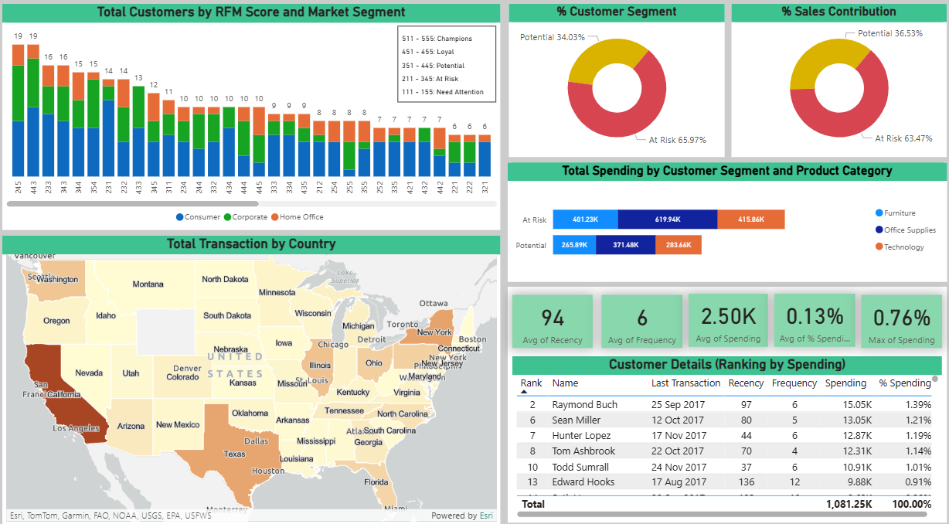
Action Needed
Action #3: Focus on Increasing Purchases from Potential Customers Action #4: Prevent the Loss of At Risk Customers
The goal is to focus on both Potential and At Risk customers by increasing their purchase frequency and spending. Several strategies can be implemented, including: Offering special discounts with minimum purchase requirements. Exclusive offers such as discounts, free shipping, or free products can encourage them to shop again. Providing product bundles or service packages to enhance perceived value. Sending personalized promotional messages based on customer behavior. For example, recommending products similar to previous purchases or items they have viewed on the company's marketplace platform. Related products can also be suggested based on customer age and location segmentation. These strategies aim to strengthen customer engagement and drive higher retention rates, ensuring long-term business growth.

Slide 19
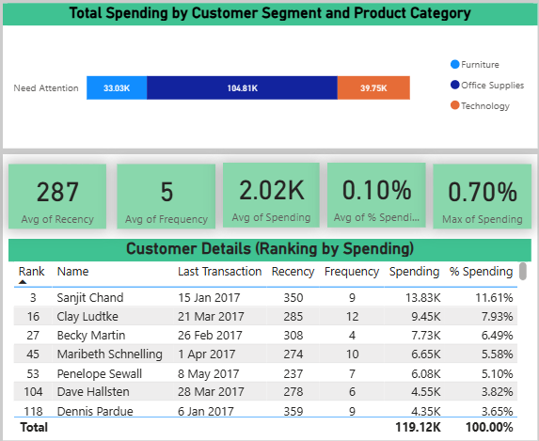
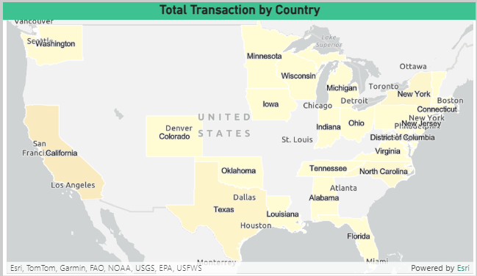
Action Needed
Action #5: Regaining the Interest of Customers Who Need Attention
Sending promotional messages—Offer products similar to previous purchases or items viewed on the company’s marketplace, such as office supplies, which are top products among the Need Attention segment. Additionally, recommend trending products based on age segmentation and customer interests. Utilizing paid advertisements on social media or other platforms targeting customers in the Need Attention segment. Conducting surveys to identify customer interests and needs in areas with a high concentration of Need Attention customers, then adjusting products to align with market demand. Providing special discounts or free shipping for customers in the Need Attention segment on their first transaction after a period of inactivity.

Slide 20
Thank you!
Do you have any questions?
noviaanggitaaprilianti

